Slide 1


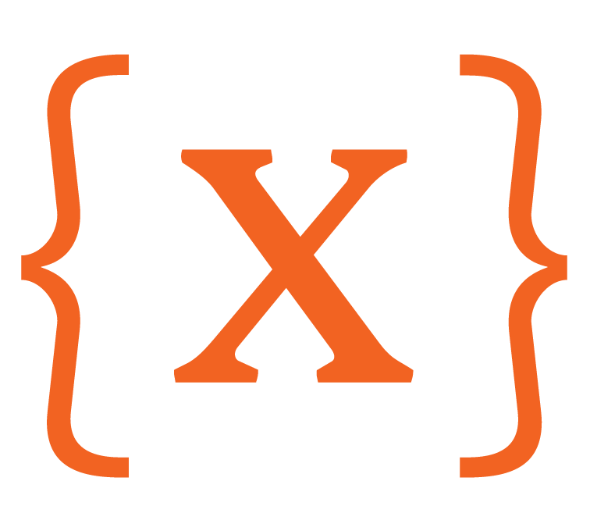

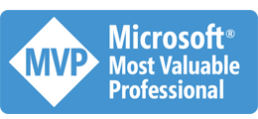

Accelerating DevSecOps
with GitHub, Azure and Azure DevOps
Colin Dembovsky
Cloud Solution Architect & Devopsologist
10th Magnitude
@colindembovsky
colinsalmcorner.com

Slide 2

What is DevOps?
“It’s a job title”
“It’s automation”
“It’s Development and Operations collaboration”
“It means faster and smaller releases”

Slide 3
“
Develop
DevOps is the union of people, process, and products to enable continuous delivery of value to your end users.
”
DevOps
Donovan Brown
Operate
Deliver
Notes:
DevOps allows us to accelerate delivery, while still delivering reliable products and services
This is about bringing people together, through shared common goals, increased collaboration and a focus on improvement
Technology plays a key role in helping to execute a DevOps strategy by enabling teams to collaborate more, enhance productivity, facilitate experimentation and automate their processes from development, through to delivery and operations
It’s also about delivering value faster by increasing efficiency, eliminating waste and streamlining feedback back to developers to continuously improve the product
The result: better products, delivered faster, to happier customers
https://medium.com/@DonovanBrown_41367/dissecting-the-definition-69151da0435f

Slide 4
46x
more frequent code deployments
That means high performers deploy multiple times per day instead of once a week or less.
440x
faster lead time from commit to deploy
That means high performers have a lead time of less than an hour instead of more than a week.
State of DevOps Report 2017: High Performing Teams

Slide 5
96x
faster mean time to recover from downtime
That means high performers recover in less than an hour instead of several days.
5x
lower change failure rate
That means high performers’ changes fail 7.5% of the time instead of 38.5%.
State of DevOps Report 2017: High Performing Teams

Slide 6
High-performing teams love automation.
They do less manual work and have automated:
33%
more of their configuration management
27%
more of their testing
30%
more of their deployments
27%
more of their change approval processes
State of DevOps Report 2017: High Performing Teams

Slide 7
Teams with the least transformative leaders were
1/2
as likely to be high performers
High-performing teams were more than
twice
as likely to be achieve or exceed objectives like operating efficiency, customer satisfaction and organizational goals.
State of DevOps Report 2017: High Performing Teams

Slide 8
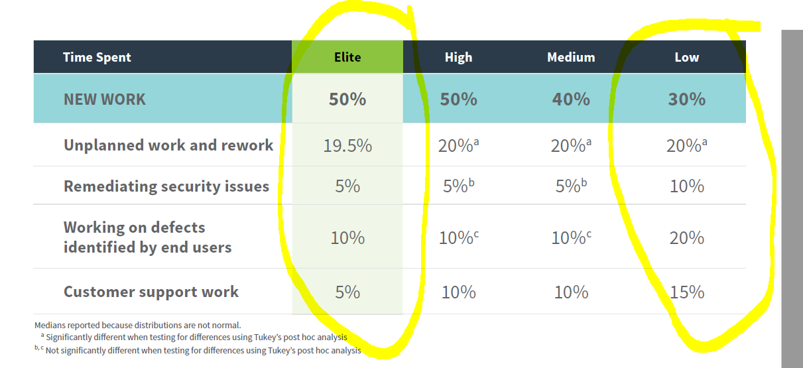
Innovation with control
Top performing DevOps companies spend more time innovating and less time “keeping the lights on”
50%
Top Performers
Low Performers
Time
30%
19.5%
20%
20%
15%
10%
10%
5%
5%
State of DevOps Report 2018
Notes:
According the 2018 State of DevOps Report, presented by DORA, the top performing DevOps companies when compared to low performers spend:
66% less time on customers support issues
50% less time on customer identified defects and remediation of security issues
More importantly they spend 66% more time on new work
They spend more time innovating, and less time keeping the lights on – enabling them to be more adaptive in their markets than their competitors

Slide 9
DevOps Habits and Practices
PRACTICES
Infrastructure as Code
Cloud Development and Test
Automatic Scaling
Sandboxing/Dev and Test Labs
Containers
Microservices
PRACTICES
Automated Testing
Continuous Integration
Continuous Deployment
Release Management
PRACTICES
Peer Code Reviews
Automated Testing
Continuous Measurement
Agile Documentation
Enterprise Package Mgmt.
PRACTICES
Usage Monitoring
Telemetry Collection Testing in Production
Stakeholder Feedback
FLOW OF CUSTOMER VALUE
TEAM AUTONOMY & ENTERPRISE ALIGNMENT
BACKLOG refined with LEARNING
EVIDENCE gathered in PRODUCTION
MANAGED TECHNICAL DEBT
PRODUCTION FIRST MINDSET
INFRASTRUCTURE is a FLEXIBLE RESOURCE
PRACTICES
Testing in Production
Usage Monitoring
User Telemetry
Stakeholder feedback
Feature flags
Experiments
PRACTICES
Application Performance Management
Infrastructure as Code
Continuous Delivery
Release Management
Configuration Management
Automated Recovery
PRACTICES
Scaling Agile
Self-managing teams
Feature crews

Slide 10

Why GitHub?
Source: 2019 Open Source Security and Risk Analysis (OSSRA) Report
Notes:
Notes:
Open source has “won” – almost ALL software has some component of open source
Open source development – where people give of their own time to contribute for free – has proven to be an incredible successful way to create some of the most popular software on the planet
Case in point: Encarta (owned by big Enterprise – Microsoft – with hundreds of paid personnel) vs Wikipedia (open source, worked on for free after-hours)
Encarta folded, while Wikipedia is almost a household name today
Studies show that 99% of large enterprise applications leverage some form of open source software and that 90% of most new code based are comprised of ~90% open source code
The “Open Source Way” – the collaboration and workflows that have made open source popular – can be leveraged at Enterprises to improve delivery and accelerate innovation

Slide 11
Open Source Software
Fundamentally shifts software development
99%
90%
of large enterprise applications leverage open source software
of open source code in new code bases
Source: 2019 Open Source Security and Risk Analysis (OSSRA) Report
Notes:
Notes:
Open source has “won” – almost ALL software has some component of open source
Open source development – where people give of their own time to contribute for free – has proven to be an incredible successful way to create some of the most popular software on the planet
Case in point: Encarta (owned by big Enterprise – Microsoft – with hundreds of paid personnel) vs Wikipedia (open source, worked on for free after-hours)
Encarta folded, while Wikipedia is almost a household name today
Studies show that 99% of large enterprise applications leverage some form of open source software and that 90% of most new code based are comprised of ~90% open source code
The “Open Source Way” – the collaboration and workflows that have made open source popular – can be leveraged at Enterprises to improve delivery and accelerate innovation

Slide 12
Microsoft ♥ GitHub
Microsoft bought GitHub for $7.5B
~40 million
users
~100 million
repos
~29 million public
Notes:
Notes:
Microsoft invested $7.5B into GitHub – despite owning their own successful code hosting solution (Azure DevOps)
Microsoft wants to “win the developer” because the developer is the heart of innovation at every business in every vertical today
GitHub has over 40M users and over 100M repos, so most developers are familiar with it already
Leveraging GitHub means tapping into this massive ecosystem

Slide 13
Siloed Security
vs
DevSecOps
Testing just before deployment
Testing happened at the end of the delivery cycle, right before release
Testing from idea to production
Testing happens alongside secure coding practices, quality gate checks, and security vulnerability fixes
Separate security expertise
Development, IT operations, and Security
teams worked independently
Shared security expertise
Developers, IT operations, and security teams all follow shared security guidelines in their work
Manual security testing
Less frequent deployments with ad-hoc manual security checks
Automated security testing
Frequent deployments with automated security checks integrated into CI/CD pipeline
Notes:
Notes:
DevSecOps is increasingly important
Case in point: Equifax breach
GitHub empowers organizations to secure the entire software supply chain
Security is for everyone, not just a few security professionals
Most organizations have “Siloed Security” that is often too little, too late
Testing is done just before deployment, often when it is too late to change
Security is left to “security pros” and worked on by isolated and separate teams
Checks are primarily manual and ad-hoc
DevSecOps seeks to improve security radically by “shifting left”
Security testing is done at every stage of the development lifecycle
Security expertise and awareness is shared across all teams
Security checks and policies are automated into CI/CD pipelines for continuous testing

Slide 14
Why GitHub?
Microsoft Focus
Inner Sourcing
Advanced Security
Open Source Workflow

Slide 15
Inner Sourcing
Enable open source culture and best practices within the Enterprise
♥
Increase collaboration
Empower teams to collaborate using the same processes and practices as open source
Break Siloes
Simplify cross-team collaboration and knowledge sharing, improve code reuse and secure workflows
Increase developer satisfaction
Empower developers to work on interests and improve skills through inner and open source practices

Slide 16


Securing the Software Supply Chain
Leverage GitHub Advanced Security
Securing usage of open source
Vulnerability Dependency Insights and automated security fixes with Dependabot
Pattern based security analysis
Always on security analysis with GitHub advanced security scanning both open source repositories and enterprise code
Global community for security
Integrated into the National Vulnerability Database, MITRE, and WhiteSource for up-to-date security information

Slide 17

Automated Workflows
GitHub Actions for CI/CD and other workflow automation
✓
Accelerate delivery through automation
Automation triggers for 20+ project events allows for automation beyond just CI/CD to any available API
Simple and easy to use
Configuration based on YAML with a host of sample workflows to learn from and get started
Global community for Actions
Thousands of open source Actions, maintained by the community and by companies offering integrations, including Microsoft Azure

Slide 18


Integration with Azure DevOps
Seamless integration for best of both
Integrate with Boards
Integrate commits, PRs and issues with Boards using AB# notation
Integrate with Pipelines
Trigger CI pipelines on commits to GitHub repos
Create GitHub releases from Azure Pipelines
Leverage GitHub Packages directly from Azure Pipelines

Slide 19
DEMO
Source: 2019 Open Source Security and Risk Analysis (OSSRA) Report
Notes:
Notes:
Open source has “won” – almost ALL software has some component of open source
Open source development – where people give of their own time to contribute for free – has proven to be an incredible successful way to create some of the most popular software on the planet
Case in point: Encarta (owned by big Enterprise – Microsoft – with hundreds of paid personnel) vs Wikipedia (open source, worked on for free after-hours)
Encarta folded, while Wikipedia is almost a household name today
Studies show that 99% of large enterprise applications leverage some form of open source software and that 90% of most new code based are comprised of ~90% open source code
The “Open Source Way” – the collaboration and workflows that have made open source popular – can be leveraged at Enterprises to improve delivery and accelerate innovation

Slide 20



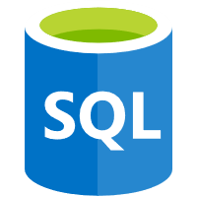








Plan & Track
Secure
Build, Test & Package
Compute & Data
Boards
Dependabot
Pipelines
Web Apps
Azure SQL
Scan
Develop
Manage Tech Debt
Canary Test
Semmle
GitHub
Traffic
Manager
Workflow
Infra-as-Code
Secrets
Review
Monitor
Actions
Terraform
KeyVault
Pull
Request
App
Insights

Slide 21
partsunlimited.azurewebsites.net
User
Traffic Manager
0
20
80
100
0
100
VIP: prod-slot
VIP: blue-slot
slot: prod
slot: blue
foo: bar
foo: zap
1.0.0
1.0.2
1.0.1
Azure SQL
Notes:
Traffic Management with Azure Web Apps
A user hits our site, foo.azurewebites.net
All users use this url – there is no 2nd url
Under the hood, we have v1.0.0 of our app in the “blue” slot
The slot has a virtual IP (vip)
The slot has some app settings, one of which is sticky to the slot
We also have a 2nd slot “green” with its own app settings and VIP
Traffic manager is routing 100% of traffic to the blue slot (vip1)
Let’s deploy v1.0.1 of our app to the green slot
This requires 0 downtime for the blue slot!!
We change traffic manager to route 20% of traffic to the green slot (vip2)
The choice is session-sticky: once a user goes to vip2, they will be on vip2 for the remainder of the session
Once we’re happy with v1.0.1 (according to telemetry), we perform a slot swap
Under the hood, Azure switches the vips (and non-sticky app settings)
We route 100% of traffic to the 1.0.1 slot

Slide 22
GitHub/Azure Repos Feature Comparison
Feature | GitHub | Azure Repos
Branches, PRs, Tags, etc. | Yes | Yes
Public/Private Repos (Cloud) | Yes | Yes
Cloud Regions | US only (currently) | Multiple
Private Server | GitHub Enterprise | Azure DevOps Server
AAD Authentication | Yes (via SAML) | Yes
Work Tracking | Issues | Boards
Package Management | Yes | Yes
CI | Yes (GitHub Actions) | Yes (Azure Pipelines)
CD | * Not enterprise-grade yet | Yes (Azure Pipelines)
Package Scanning | Yes | * In pipelines, not free
Code Analysis | Yes, Semmle (free/paid options) | * In pipelines, not free
Policies | Yes | Yes

Slide 23
GitHub Actions/Azure Pipelines Comparison
Feature | GitHub Actions | Azure Pipelines
UI Editor | No | Yes (Classic)
YML Definitions | Yes | Yes
Templates | No | Yes
Triggers for Source Code Events | Yes | Yes
Triggers for Other Events | Yes | Yes* (with WebHooks)
Build Number | No | Yes
Secrets | Yes | Yes
Variable Groups | No | Yes
Environments | No | Yes
Metrics | No | Yes
Repos | Only GitHub | Any
MarketPlace | Yes | Yes

Slide 24
Which should I use?
Mostly open source technologies/dependencies
Strong security compliance requirements
Autonomous teams, modern Project Management
Work Item Management not in Boards
Strong “inner sourcing” culture
Greenfield or migrating from other Git hosts
GitHub
~probably
Limited use of open source
Require gates and approvals for Releases
Centrally managed teams
Work Item Management in Boards
Data sovereignty requirements
Already in Azure Repos
Azure Repos
~probably

Slide 25

Best of Both
Repos
Pull Requests and Policies
Security Scanning
Inner Sourcing
Possibly CI
Work Item Management with Boards
CI, but definitely CD
Test Management

Slide 26
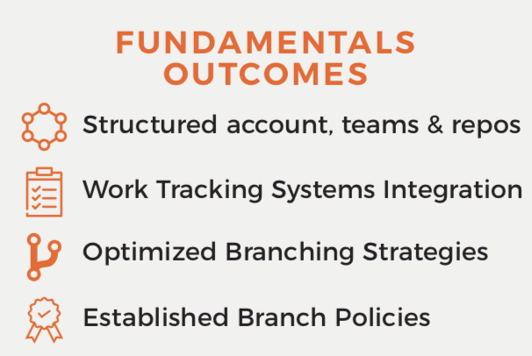
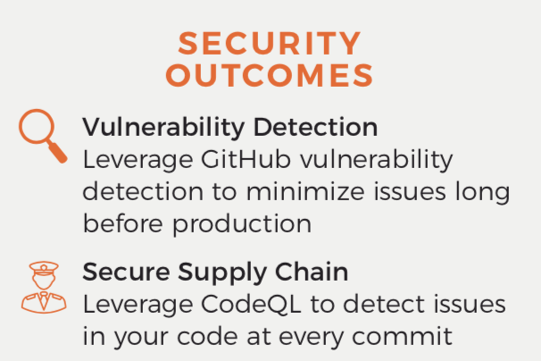
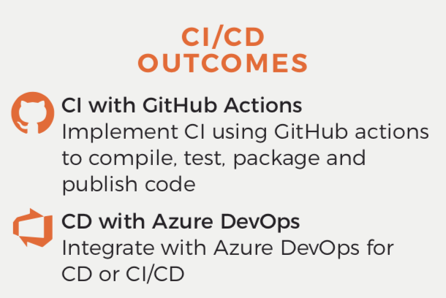
GITHUB ADOPTION QUICKSTART
PHASE 1
FUNDAMENTALS AND INNERSOURCING
Optimally structure your GitHub organization/teams, and import or migrate existing source code from other source control systems. Whiteboard, implement, and socialize the most effective branching strategies to improve work isolation and quality. Integrate to work item tracking tooling for traceability.
PHASE 2
SECURE THE SUPPLY CHAIN
Leverage GitHub’s advanced security tools to secure your software supply chain. Leverage automatic variant analysis for detecting vulnerabilities and their variants early and prevent them from reaching production. Create workflows that automatically suggest fixes for vulnerable dependencies.
GitHub is synonymous with open source development, but continued evolution in the platform now makes it a compelling solution for DevSecOps in enterprise development. Adopt Inner Sourcing in your organization through GitHub to leverage the huge success of Open Source Development processes. Secure your software supply chain using GitHub’s advanced security features. Automate workflows using GitHub Actions. Boost your DevSecOps journey through 10th Magnitude’s 2-week interactive GitHub Adoption Quickstart.
PHASE 3
CONTINUOUS INTEGRATION (CI)/ CONTINUOUS DELIVERY (CD)
Focus on automation using best of breed tools. Utilize GitHub Actions for CI and automating processes. Utilize Azure Pipelines for CD to automate deployments to environments. Dramatically improve your commit-to-production process, reduce cycle times and increase the quality of your software.
“The developer ecosystem in an organization is front and center as every company in the world turns into a software company. GitHub catalyzes this.”
Peter Levine, General Partner Andreessen Horowitz
Request more information here.
View in the Azure Marketplace.
Notes:
GITHUB ADOPTION QUICKSTART
PRICING
$25,000
*May vary by number of repos, teams, and pipelines.

Slide 27


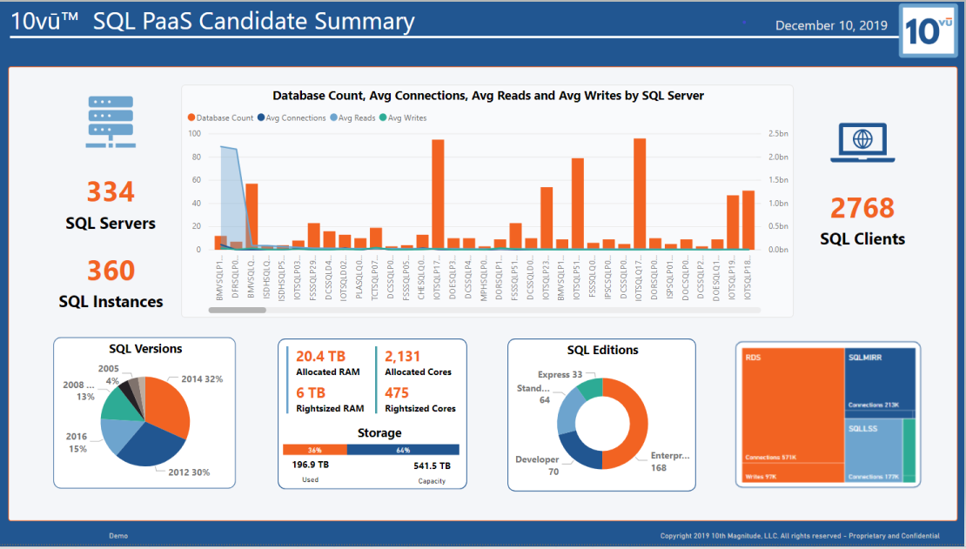
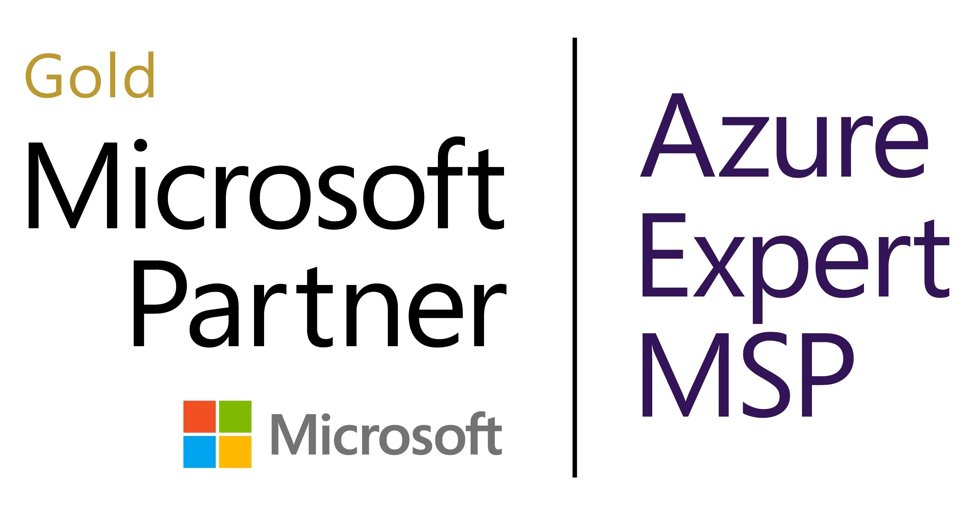
10vūTM APPLICATION MODERNIZATION ASSESSMENT
ACCELERATE YOUR CLOUD JOURNEY WITH A 10vūTM APPLICATION MODERNIZATION ASSESSMENT.
STEP 1: SCOPING SESSION
Determine priority applications to evaluate and identify the expected dependencies and business value. Review readiness for PaaS deployments of existing Azure landing zone(s).
STEP 2: DATA COLLECTION
Data collection is performed with a tool most appropriate for your assessment.
STEP 3: DESIGN SESSIONS
Your customized assessment will provide a PaaS architecture implementation road-map, a high-level application modernization prescription, an application risk/readiness/complexity evaluation, and an associated run and transformation cost estimate.
Powered by
Perform application inventory and identify target PaaS candidates. Explore with application stakeholder(s) the future state options/opportunities and ideal application requirements to most effectively serve the business.
STEP 4: RECOMMENDATIONS
Demonstrate potential target Azure architecture(s) for future state and review the high-level application(s), recommended remediation plan, and architecture transformation.
Request more information here.
View in the Azure Marketplace.

Slide 28
ABOUT 10th MAGNITUDE

Slide 29

WHAT WE DO: DIGITAL TRANSFORMATION
We help organizations
innovate, lead, and disrupt.
​10th Magnitude creates​ the path for organizations to stay competitive, become industry disruptors, and reach new heights through cloud-enabled innovation.​
Notes:
SPEAKER NOTES
We’re unique in a few important ways:
All we have ever done has been in the cloud. In fact, we launched our business the same month Microsoft launched Azure and we’ve been alongside MS ever since.
Global firm
Recognized by MS as the Global leader in Azure
Serving companies of all industry and size
Focus on bring innovation to our customers through digital transformation

Slide 30

ABOUT 10th MAGNITUDE
Industry-leading cloud services firm with offices across the U.S. Chicago | Dallas | Seattle | New York | Tulsa
Established in the cloud. Helping clients leverage the cloud. 100% Microsoft Azure. Helping you lead, innovate, and disrupt in the cloud.
Serves global and regional companies across various verticals Manufacturing | Retail | Financial/Professional Services | Healthcare | Government
Microsoft award-winning global partner 2019 Global Datacenter Migration Partner of the Year 2019 Global DevOps Partner of the Year 2018 Global Open Source Applications and Infrastructure on Azure 2018 US Apps and Infrastructure – Datacenter Transformation 2017 Global Hybrid Cloud and Infrastructure Platform
End-to-end cloud innovation services Experienced Professional Services + Managed Services
Notes:
SPEAKER NOTES
We’re unique in a few important ways:
All we have ever done has been in the cloud. In fact, we launched our business the same month Microsoft launched Azure and we’ve been alongside MS ever since.
Global firm
Recognized by MS as the Global leader in Azure
Serving companies of all industry and size
Focus on bring innovation to our customers through digital transformation

Slide 31





MODERN ENTERPRISE FRAMEWORK
DATA CENTER
TRANSFORMATION
DATA ESTATE MODERNIZATION
Embrace a cloud strategy built
to modernize your infrastructure,
applications, and business.
Modernize your data estate to deliver insights, improve customer experience, and unify your data-driven culture.
APPLICATION
MODERNIZATION
MANAGED SERVICES
Reduce costs, improve quality,
and get value into your customer’s
hands quickly.
Reduce operational demands on
your staff so they can focus on your
business, not your IT.

Slide 32
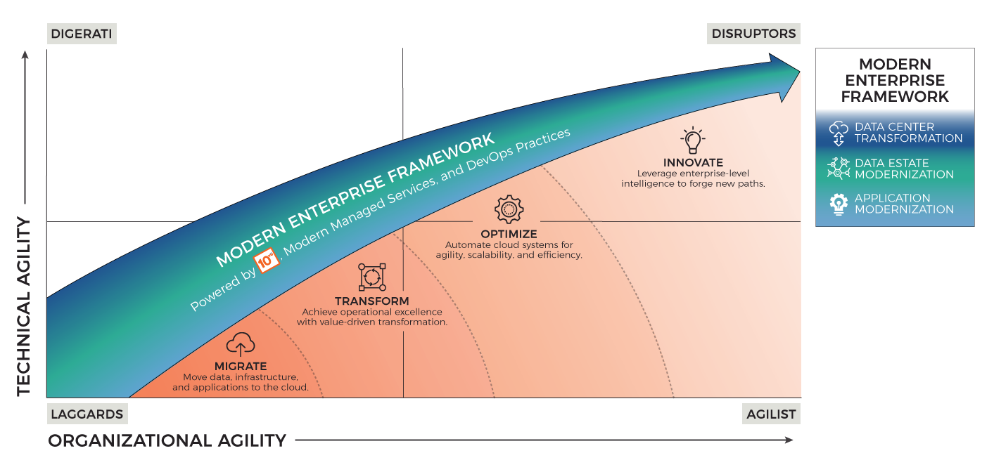
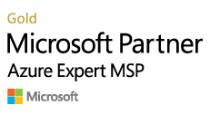
AGILITY QUADRANT Be the leader. Drive industry change. Innovate.

Slide 33
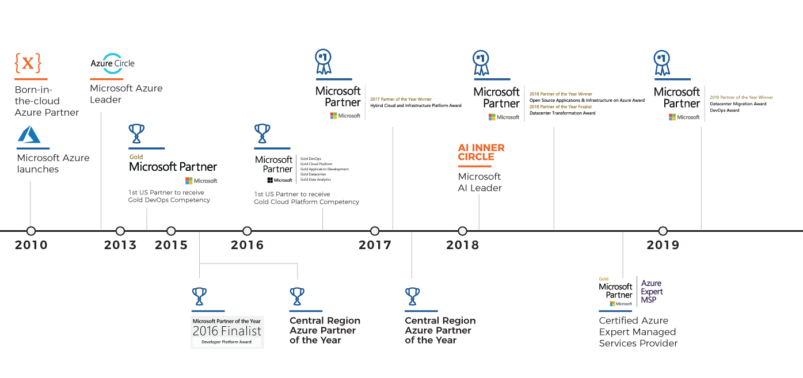
PARTNERING WITH MICROSOFT SINCE 2010

Slide 34
10th MAGNITUDE MANAGED SERVICES

Slide 35






10th Magnitude Managed Services
At-a-glance
Azure Expert
MSP
100% USA
Based Support
Cloud Born
Enterprise Focus
Modern Approach
4 Time Microsoft Partner
of the Year Winner
5 Gold Competencies
24x7x365 Global Support from our Operation Center
in Tulsa, Oklahoma
We only focus
on Azure
management
IaaS/PaaS/DevOps
monitoring,
management,
and support for your
Azure Infrastructure
Modern Service
Management, DevOps,
Automation

Slide 36
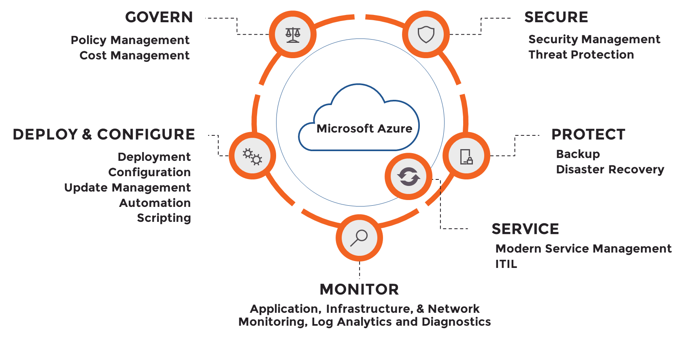
Managed Service Methodology

